Slide 1
Functional Programming
Notes:
Talk you about FP
PL consultant
Doing FP
People get excited ,
Category Theory , Monads,
We will do with clojoure module.

Slide 2
What is it How to ? Does it work?
Notes:
What is FP
How To Start with
Does it really work or another fancy word

Slide 3
What is it How to ? Does it work?
Notes:
What is FP
How To Start with
Does it really work or another fancy word

Slide 4

Vicks - 1

Slide 5
Functional Programming Forget Everything you know about programming
Notes:
In Google ,Youtube , They are saying
Ordinary Programmers
FP – forget everything you think you know about programming

Slide 6
What do you know?

Slide 7
Program
Classes
Inheritance
packages
List
Map
String
Numbers
Booleans
Indentation
variables
variable=value
conditions
loop
methods
Notes:
What we have?
Variables
Assignment
Are we going to Throw all these

Slide 8
Functional Programming Forget Everything you know about programming
Really?
Notes:
Re inventing the wheel
Should we need to forget everything?
What do we really want to do

Slide 9
Functional Programming Refactor Everything you know about programming
Notes:
Is more of a refactoring
I am going to take something which works, for others , I am going to refactor

Slide 10
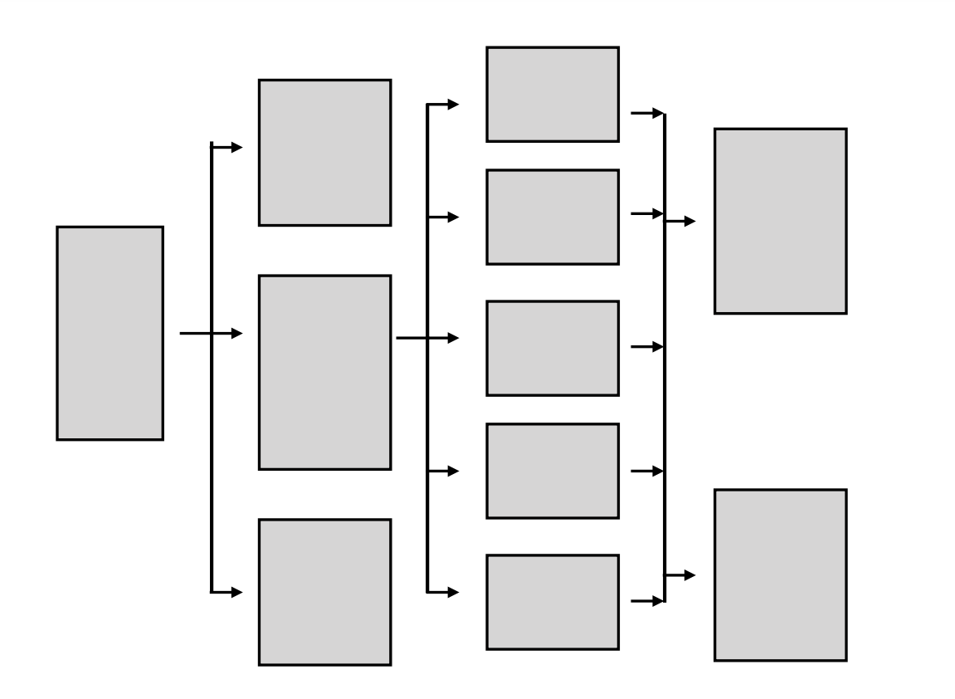
Notes:
Consider Accounting Application we have a system

Slide 11
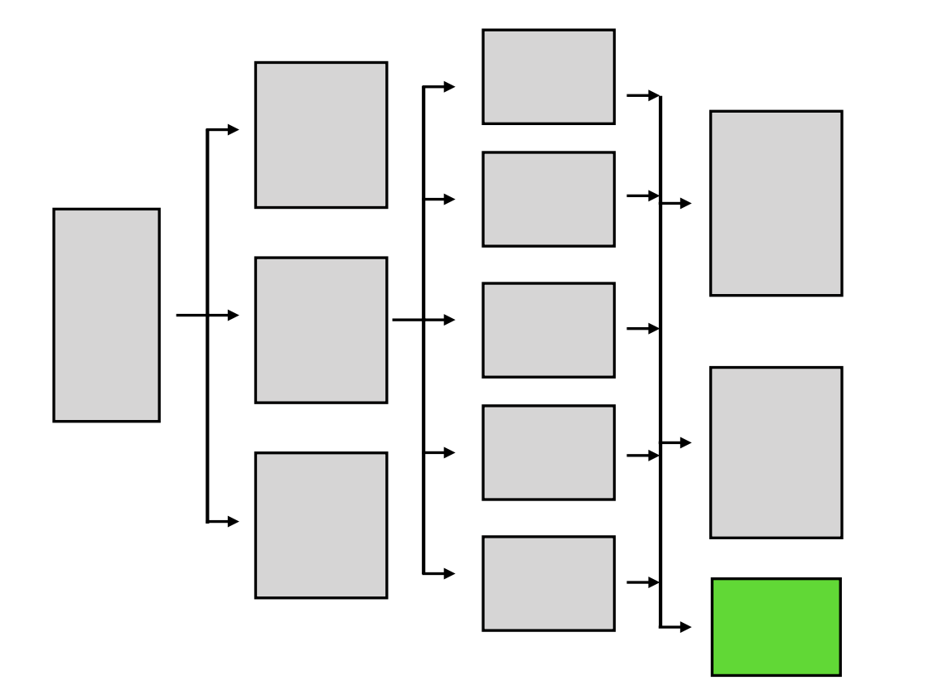
Notes:
We have added a module

Slide 12
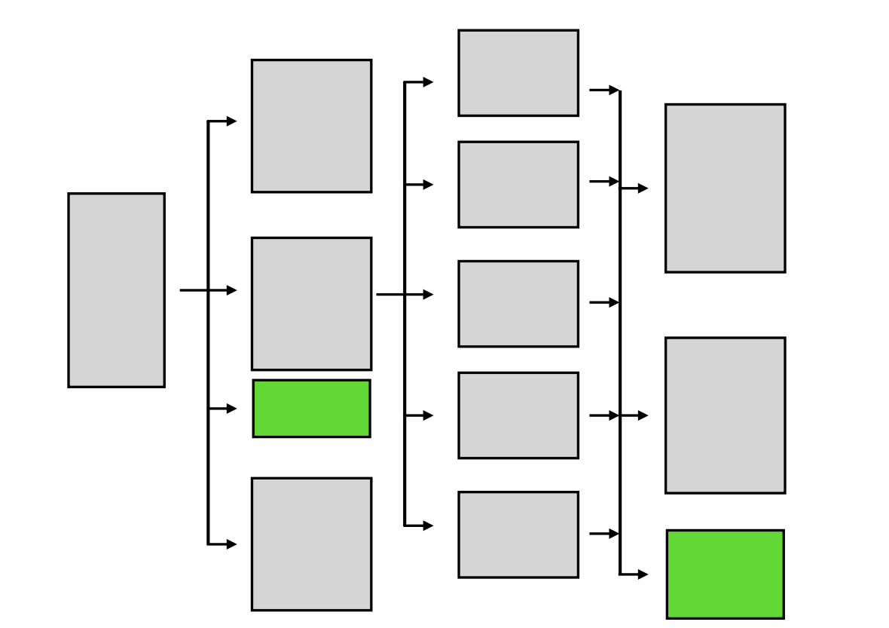
Notes:
We have added another module

Slide 13
Notes:
We have removed two systems

Slide 14
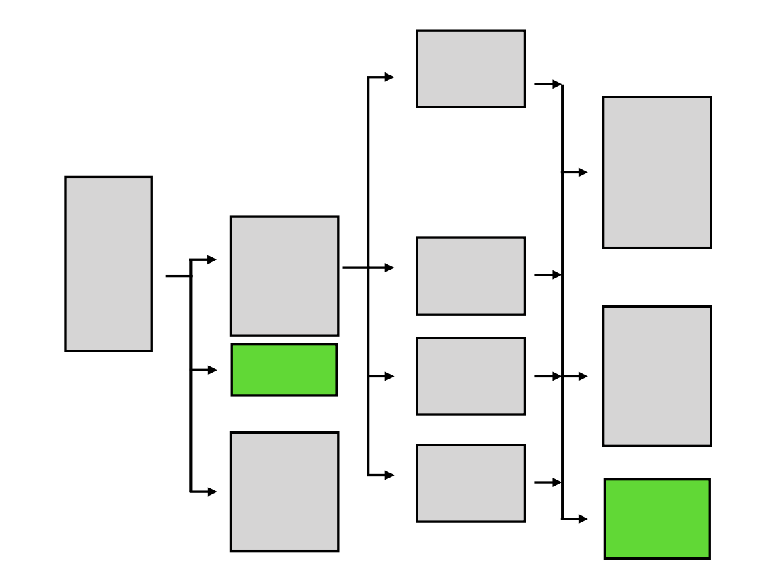
Notes:
We have removed two systems

Slide 15
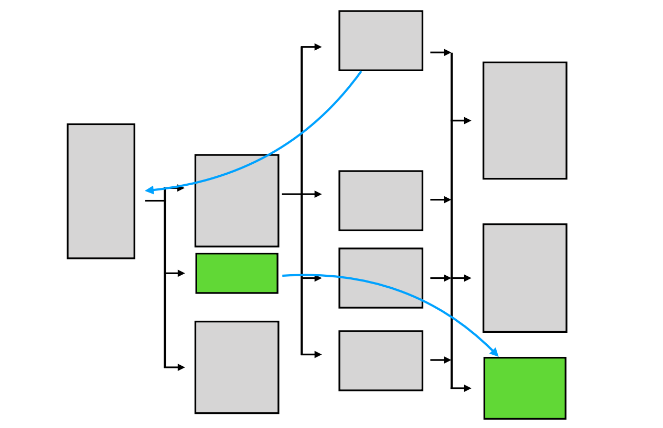

Slide 16
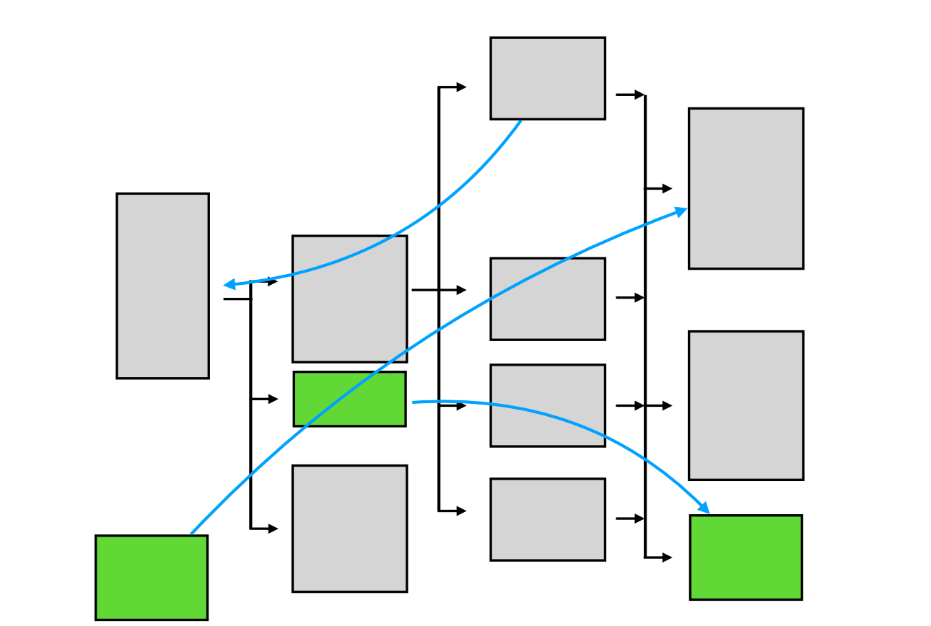

Slide 17
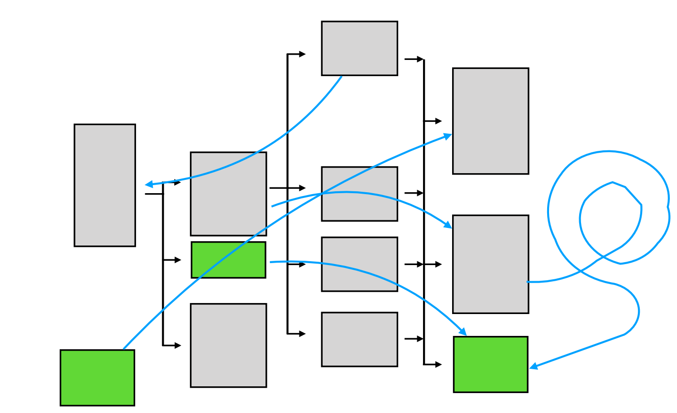

Slide 18
It Works
But

Slide 19
Mess

Slide 20

Notes:
To Rewrite
Take a clean sheet

Slide 21
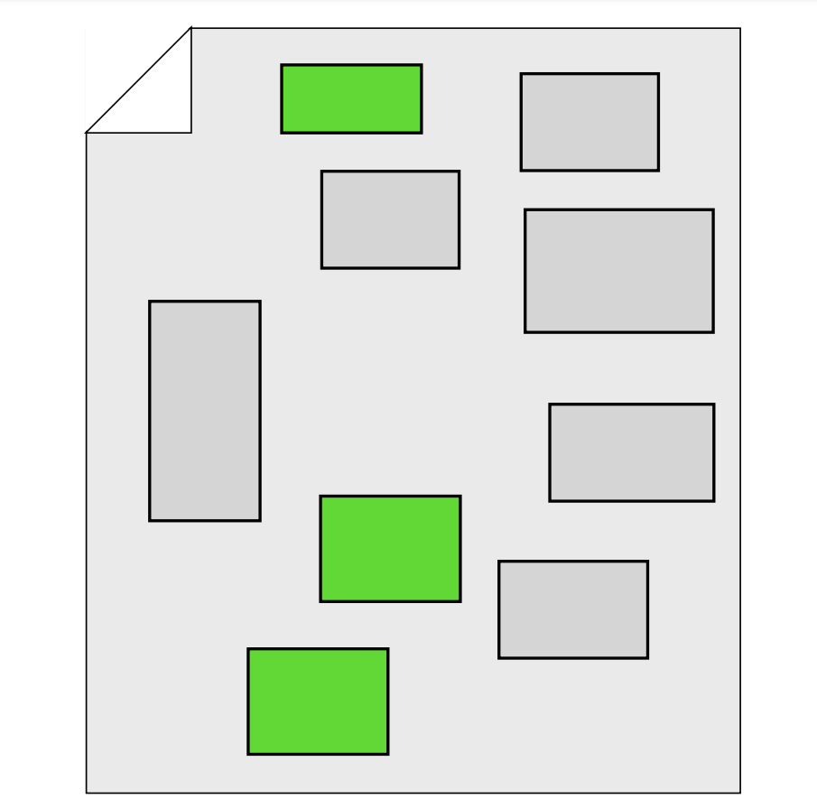
Notes:
Some Modules which worked

Slide 22




Slide 23
What About
Programming?

Slide 24
During the type erasure process, the Java compiler erases all type parameters and replaces each with its first bound if the
type parameter is bounded,
or Object if the type parameter is unbounded.
https://docs.oracle.com/javase/tutorial/java/generics/genTypes.html

Slide 25


During the type erasure process, the Java compiler erases all type parameters and replaces each with its first bound if the
type parameter is bounded, or Object if the type parameter
is unbounded.

Slide 26
Protected methods: a protected method is similar to a private method, with the addition that it can be called with, or without, an explicit receiver,
but that receiver is always
self (it’s defining class) or an object that inherits from self .
https://medium.com/@tjoye20/ruby-access-control-basics-public-vs-private-vs-protected- methods-7788b26e04a7

Slide 27
A friend function of a class is defined outside that class' scope but it has the right to access all private and protected members of the class. Even though the prototypes for friend functions appear in the class definition, friends are not member functions.
https://www.tutorialspoint.com/cplusplus/cpp_friend_functions.htm

Slide 28
Programs
Classes
Inheritance
Methods
Namespaces
Arrays
Hashes
Strings
Numerics
Booleans
Indentation
Names
Name = Value
Ifs
Iteration
Procedures

Slide 29
Messy?

Slide 31
Program
packages
List
Map
String
Numbers
Booleans
conditions
loop
methods
variables
variable=value
Indentation

Slide 32
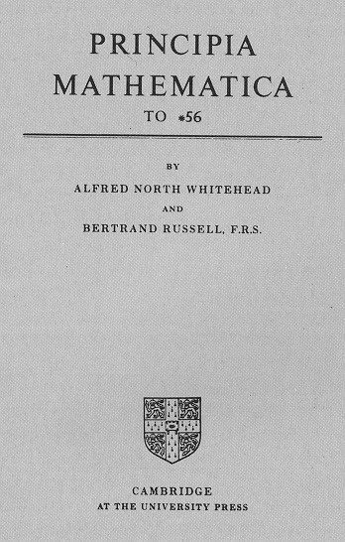

Slide 33
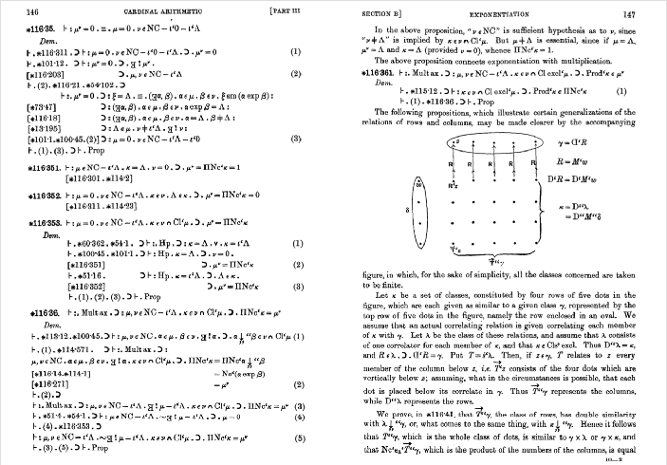
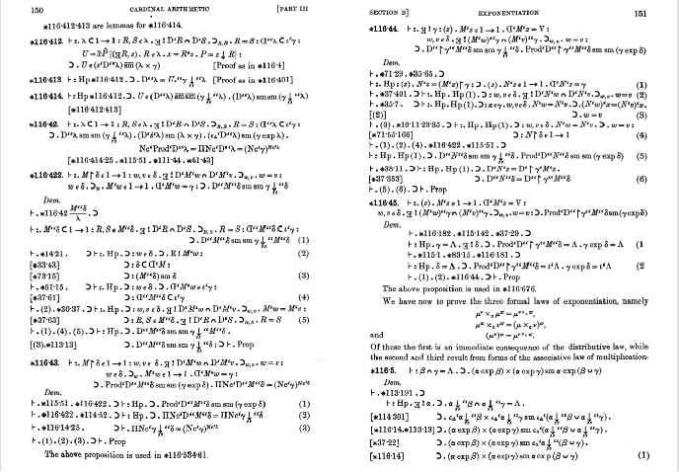

Slide 34
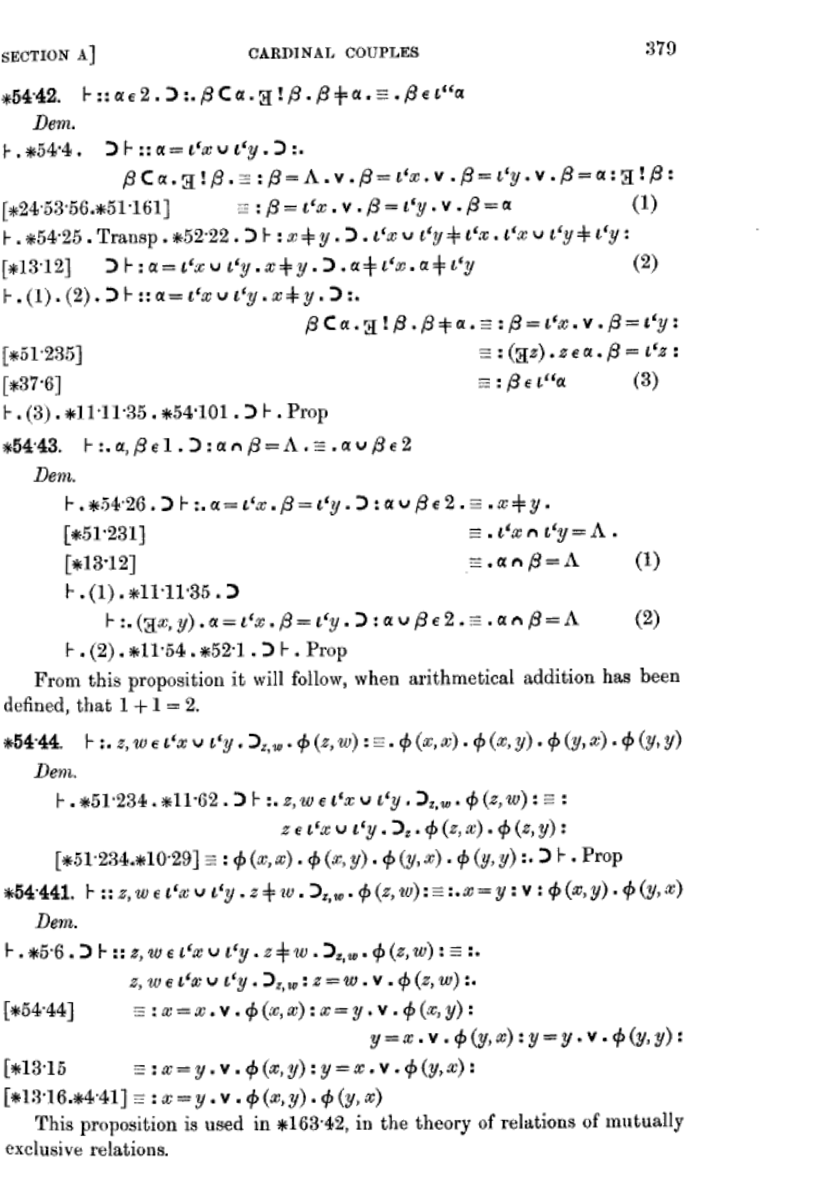

Slide 35
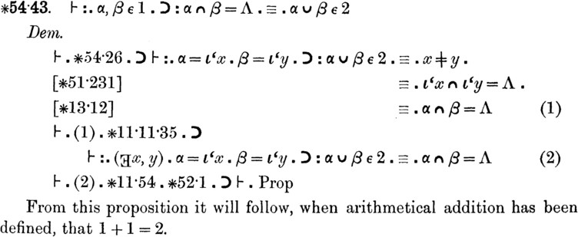

Slide 36
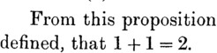

Slide 37
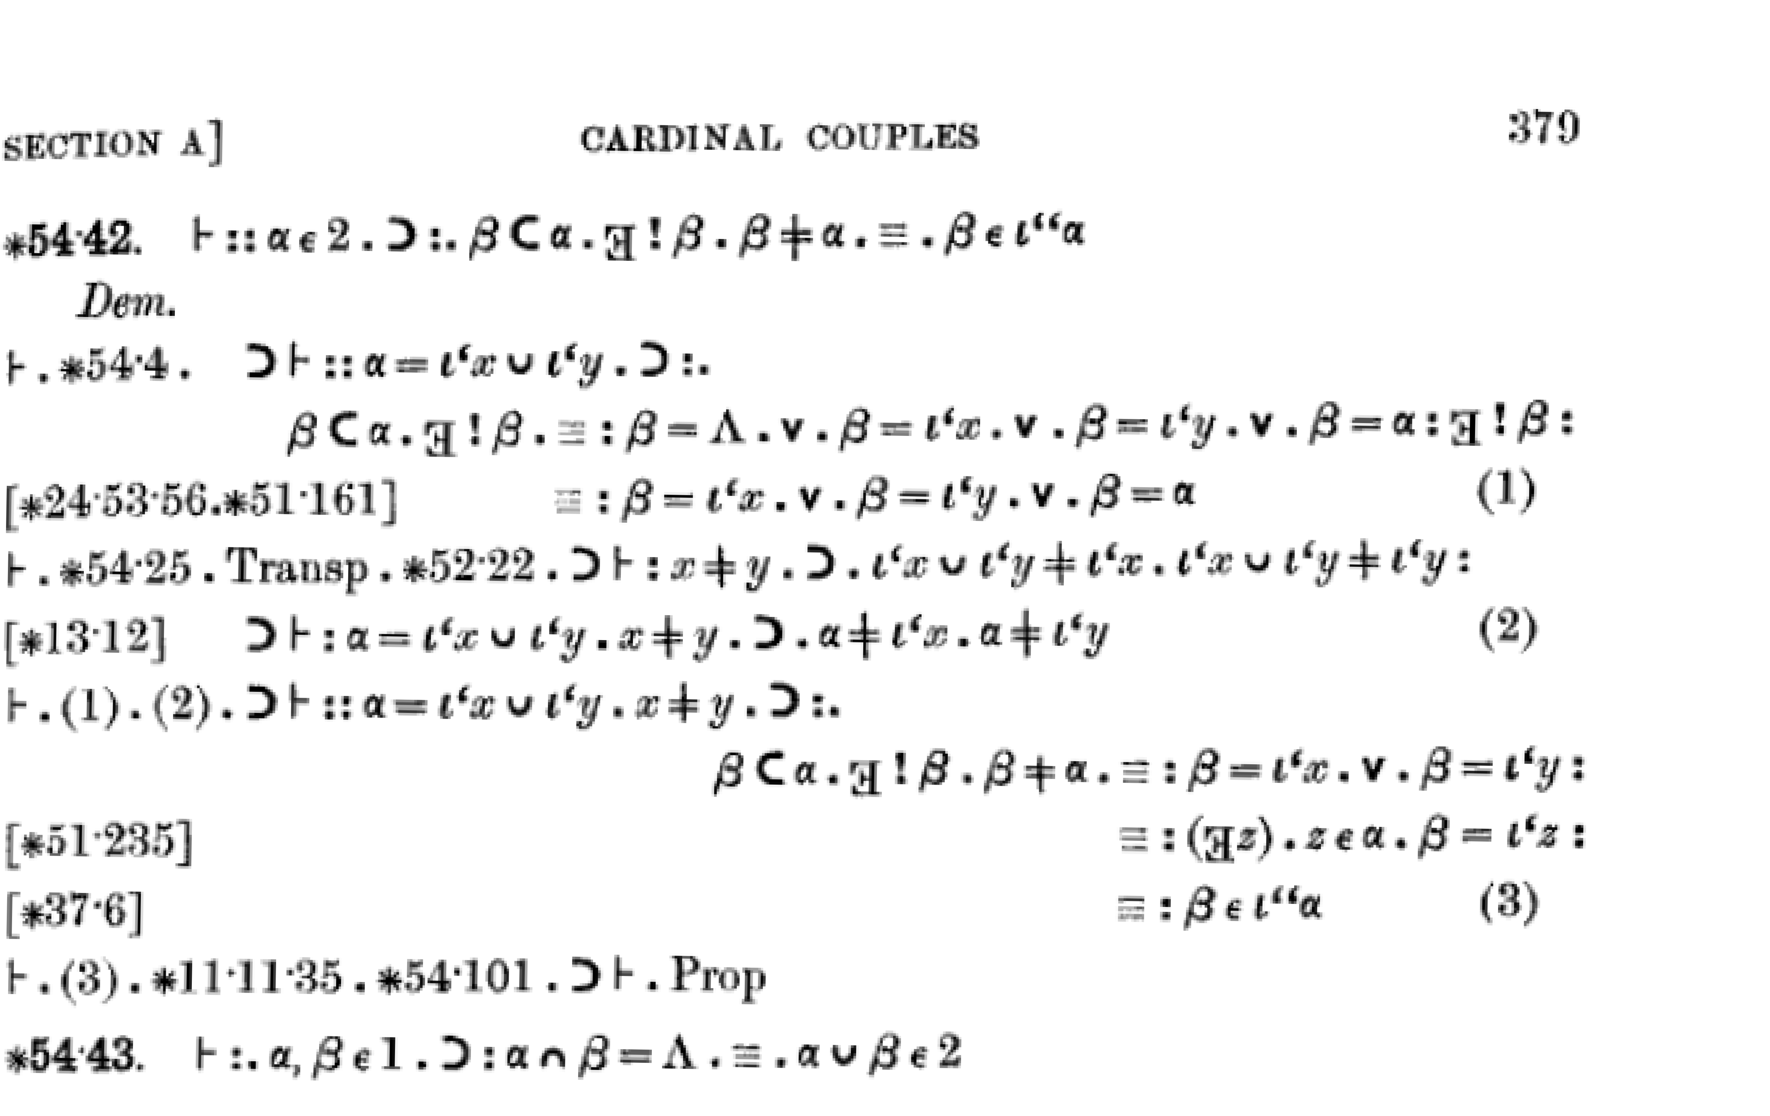

Slide 39
f(x)

Slide 40


f(x)
2
4
1
2
6 8
10
3
5
4

Slide 41

2
4
1
2
6 8
10
3
5
4

Slide 42
Methods
Procedures Subroutines Functions

Slide 43


6
3
5
10

Slide 44


6
3
5
42
10 ??

Slide 45
6
3
5
10

Slide 46


6
3
5
10

Slide 47
A Thing
f(x)

Slide 48
A Thing I Can Make
f(x)

Slide 49
f(x)

Slide 50
1st Class

Slide 51
Look at Input
Produce Output

Slide 52
No Side Eﬀects

Slide 53
x = ['a','b','c']
y = a(x) x = ?

Slide 54
x = ['a','b','c']
c(a(x) + b(x)) + d(x) * e(x) - 4 * (q(x) - f(x)) +
d(x) * e(x) - 4 * (q(x) - f(x)) + b(x)) + d(x) /
c(a(x) + b(x)) + d(x) * e(x) + g(x) + h(x) *
floor(b(x)) + 16 * a(x) - ceil(g(x) - c(a(x) + b(x)) + d(x) * e(x) - 4 * (q(x) - f(x)) +
d(x) * e(x) - 4 * (q(x) - f(x)) + b(x)) + d(x) /
c(a(x) + b(x)) + d(x) * e(x) + g(x) + h(x) * floor(b(x)) + 16 * a(x)
y =
x = ?

Slide 55
f(x)
Program
packages
List
Map
String
Numbers
Booleans
conditions
loop
methods
variables
variable=value
Indentation

